Slide 1
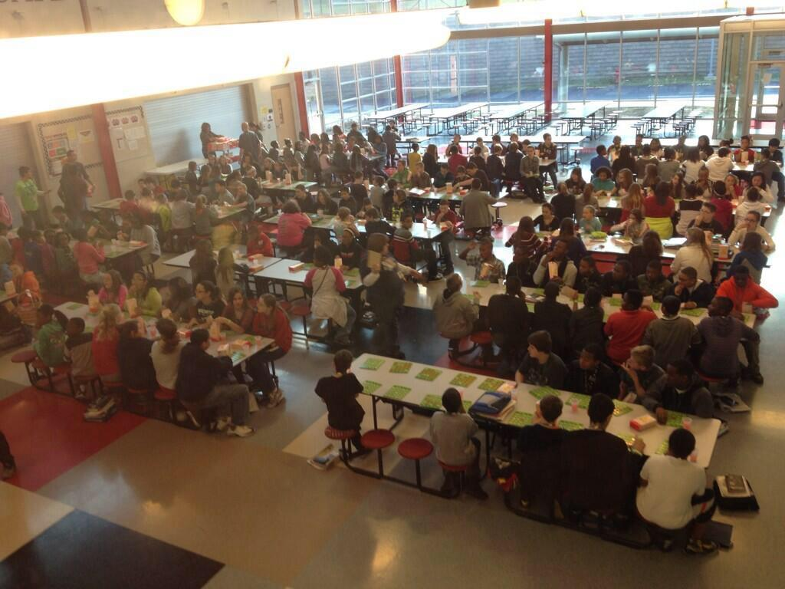
Implementing
Efective Interventions
With Student Outcomes in Mind
MSCA 2015
Notes:
Begin at 2:45

Slide 2
Resources
Resources for today’s session can be found at http://onewildcounselor.weebly.com/msca-2015.html
Notes:
2:47

Slide 3
Participant Outcomes
Knowledge of different data and how data is used
Assess current interventions by using the Targeted Intervention Inventory
Understand the importance of developing Intervention Guidelines
Notes:
2:48

Slide 4
About Me
Currently…
PBIS Facilitator for past two years at
Special School District of St. Louis County
Recently...
School Counselor previous seven years
at Hazelwood West Middle
Notes:
2:49
Currently…
PBIS Facilitator with Special School District of St. Louis County
Facilitate learning AND assisting schools with building a MTSS
Coach Ritenour, Pattonville & Webster Groves school Districts
Recently...
School Counselor past seven years at Hazelwood West Middle
Directed youth recreational and social programming for the previous 10 years in homeless & at-risk youth centers & city recreation departments

Slide 5
Who is Here?
Elementary
Middle
High School
Administration
Who is Left?
Notes:
2:50

Slide 6
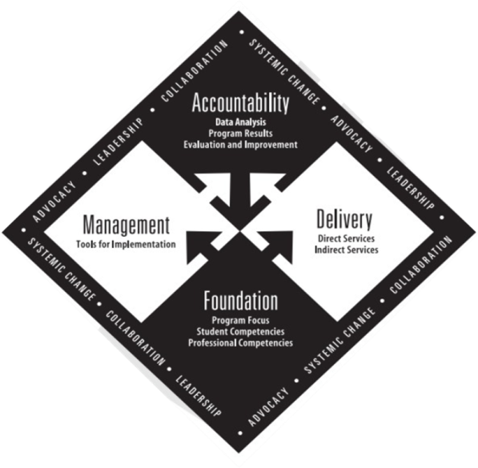
We Need a Framework!
While your vision and beliefs direct
your desired outcomes…
Data should drive
your decision making.
Notes:
2:52

Slide 7
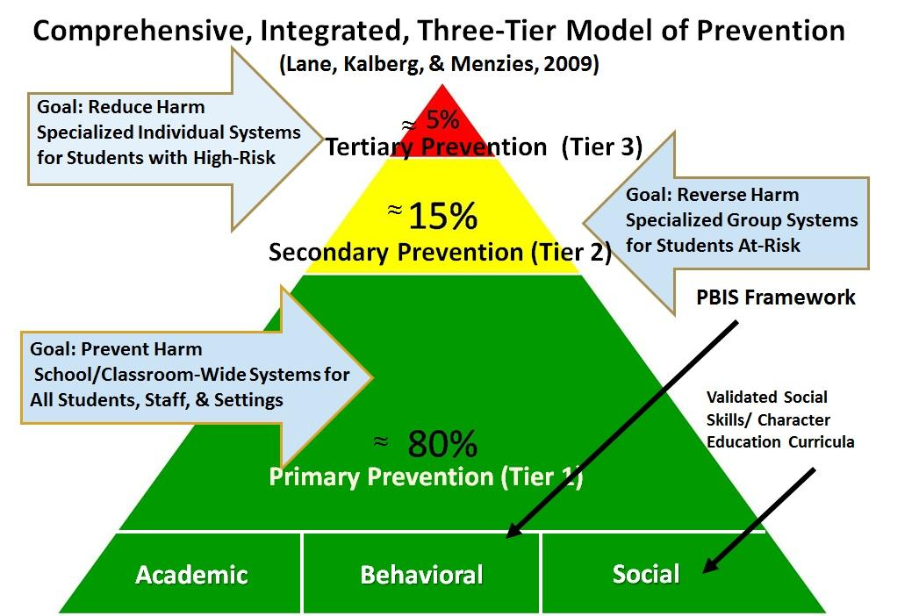
Where Does School Counseling Fit?
Notes:
2:56

Slide 8
Paradigm Shift
Guidance Counselor
Reactive
Services provided to few or one at a time
Impact measured by feelings or perceptions
Supportive role to school improvement
Counsel in isolation or aimlessly
Notes:
2:57

Slide 9
Paradigm Shift
Professional School Counselor
Proactive & Data Driven
Services provided to all
Impact measured by achievement data
Essential role in school process
School counselor integral school leader
Notes:
2:58

Slide 10
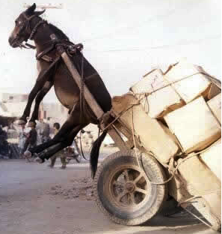
Want to Shift the Approach?
Does it feel like the School Counseling support provided is about responding to crisis or about providing supports for predicted behavior?

Slide 11
Creating Effective Interventions
Step 1: Assess Current Interventions
Step 2: Using Data to Identify Student Need
Screening, ODR, Attendance, Academic, Minor Incidents
Step 3: Identify & Describe Intervention
Step 4: Create Intervention Guidelines: Determine Entry Criteria
Step 5: Identify Outcome Measures
Step 6: Identify Exit Criteria
Step 1: Construct your assessment schedule
Step 2: Identify your secondary (Tier 2) supports
Existing and new interventions
Step 3: Determine entry criteria
Nomination, academic failure, behavior and academic screening scores, attendance data etc.
Step 4: Identify outcome measures
Pre and post tests, CBM, office discipline data, GPA, state assessments, etc.
Step 5: Identify exit criteria
Reduction of discipline contacts, demonstration of grade level performance based on academic progress monitoring data, reduction of truancies and absences, etc.
Step 6: Consider additional needs
Notes:
3:03

Slide 12
Key Features of Targeted Interventions
Increase structure and feedback
Is temporary
Provides regular & frequent opportunities for success and recognition
May include social, social emotional and/or behavior skills instruction
May require academic assistance
Transfer and Generalization Plan
Shout out!
What are some of your school’s current targeted interventions?
Notes:
3:05

Slide 13
Assess Current Interventions
Creating Effective Interventions
Identify one of your school’s current targeted intervention?
Complete this inventory of your current practices and identify the following components for that intervention.
We will use this information to develop an Intervention Guideline!
Notes:
3:09

Slide 14
Creating Effective Interventions
Step 1: Assess Current Interventions
Step 2: Using Data to Identify Student Need
Screening, ODR, Attendance, Academic, Minor Incidents
Step 3: Identify & Describe Intervention
Step 4: Create Intervention Guidelines: Determine Entry Criteria
Step 5: Identify Outcome Measures
Step 6: Identify Exit Criteria
Step 1: Construct your assessment schedule
Step 2: Identify your secondary (Tier 2) supports
Existing and new interventions
Step 3: Determine entry criteria
Nomination, academic failure, behavior and academic screening scores, attendance data etc.
Step 4: Identify outcome measures
Pre and post tests, CBM, office discipline data, GPA, state assessments, etc.
Step 5: Identify exit criteria
Reduction of discipline contacts, demonstration of grade level performance based on academic progress monitoring data, reduction of truancies and absences, etc.
Step 6: Consider additional needs
Notes:
3:10

Slide 15
Creating Effective Interventions
Using Data to Identify Student Need
Process
Perception
Student Need
Outcome
Step 1: Construct your assessment schedule
Step 2: Identify your secondary (Tier 2) supports
Existing and new interventions
Step 3: Determine entry criteria
Nomination, academic failure, behavior and academic screening scores, attendance data etc.
Step 4: Identify outcome measures
Pre and post tests, CBM, office discipline data, GPA, state assessments, etc.
Step 5: Identify exit criteria
Reduction of discipline contacts, demonstration of grade level performance based on academic progress monitoring data, reduction of truancies and absences, etc.
Step 6: Consider additional needs
Notes:
3:12
Process Data: Number of participants  Evidence that event occurred  How activity was conducted  Did the program follow the prescribed practice?
Eight fourth-grade students participated in a study skills group that met six times for 45 minutes  450 ninth-graders completed an individual learning plan  38 parents attended the middle school orientation meeting – Office Discipline Data
Perception Data: (Social Validity)
Attainment of competencies  Changes in attitudes and beliefs  Perceived gains in knowledge
100 percent of sixth-graders can identify three career interests  89% of students demonstrate knowledge of promotion/ retention criteria  92% can identify early warning signs of violence  93 % of fourth-graders believe fighting is not an appropriate method of solving problems  69 % of all students report feeling safe at school  90 % of the parents report benefiting from a presentation on college entrance requirements
Outcome Data: Evidence that the intervention or activity has had an impact on students ability to utilize the knowledge, attitudes and skills 1. Attendance 2. Behavior 3. Academic achievement
Achievement State test data for math increased by 3 points. Attendance Attendance increased from 91 to 94% Behavioral Discipline referrals decreased by 30%

Slide 16
Student Identification
Creating Effective Interventions
At least 2 data sources are used to identify students for Secondary Supports at least three times a year.
A written policy exists and staff are trained.
Staff & family are notified of intervention identification
Notes:
3:13
TFI outlines multiple data sources to identify students for Tier 2/3
Additionally, keep in mind Function of student behavior, strengthening the problem solving process

Slide 17
Using Data to Identify Student Need
Creating Effective Interventions
Universal Screeners (SRSS, AIMSweb, SSBD, BESS etc.)
Student Outcome Data:
Office Discipline Referrals (ODRs)
Suspensions
Attendance
Tardies
Academics
Requests for Assistance only used as a prompt to examine student outcome data for formal interventions
Minors
In-School detentions
Interclass Time-out / “Think Time”
Notes:
3:14
At this point you are going to think about what data is relevant to your school your context.
What data is the gate keeper? Usually it is screening data
What other data will use you use to cross reference the data sources to see if a student needs an intervention?

Slide 18
Behavior Screening
Creating Effective Interventions
Proactive Approach
Provide students with equal access to interventions
Information on behavioral or social skills can inform instruction and how to intervene
The relationship between academic and behavior
To ensure that there are data driven decisions
Notes:
3:15

Slide 19
Behavior Screening Benefits & Best Practices
All students are screened
Measures the overall level of risk present in a school over time
Identifies students who may require more targeted supports in the form of secondary and tertiary interventions
Generally administered 3 times in a school year- starting 6 weeks in to the school year
By the end of October students should be engaged in an intervention
Provides benchmarking data on student improvement and power of interventions across students
Notes:
3:16

Slide 20
Measure | Authors | Ordering Information
Systematic Screening for Behavior Disorders (SSBD) | Walker & Severson (1992) | Available for purchase from Cambium Learning/ Sopris West
Early Screening Project (ESP) | Walker, Severson, & Feil (1995) | Available for purchase from Applied Behavior Science Press
Student Risk Screening Scale (SRSS) | Drummond (1994) | Free
Strengths and Difficulties Questionnaire (SDQ) | Goodman (1997) | Free online at http://www.sdqinfo.com/
AIMSweb
Screening for Systems Development
On-line
Notes:
Choose slide 57 or 58 to use

Slide 21
Student Risk Screening Scale Middle School Fall 2004 - Fall 2011
n = 12
n = 20
n = 507
Percentage of Students
N=534
N=502
N=454
N=470
N=477
N=476
N=524
N= 539
Fall Screeners
Notes:
3:17

Slide 22
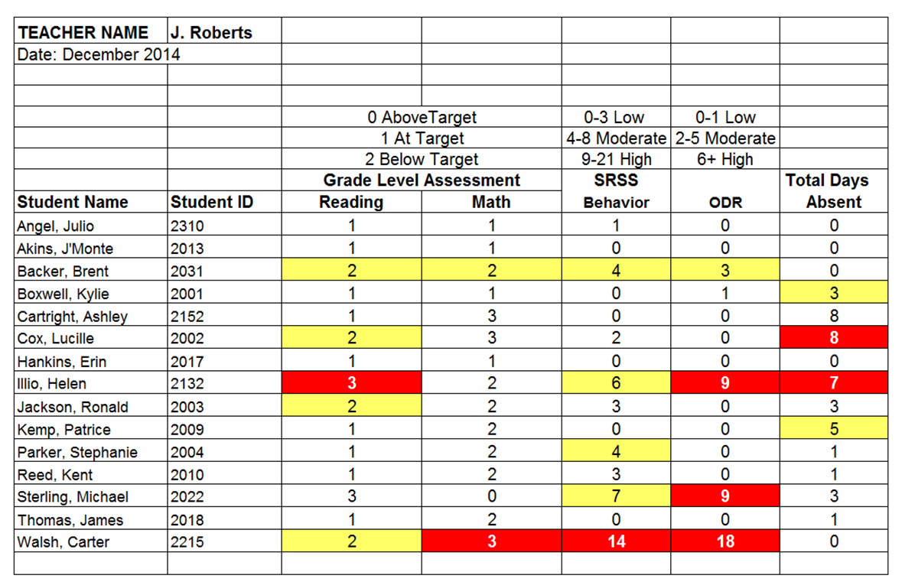
Behavior Screening Examining Academic & Behavioral Data
Lane, Oakes, Ennis & Hirsch, (2014)
Notes:
3:18
Conversation around District expectations for screening. District Leadership Team
Family conversations or communication around students have access to Tier 2 interventions and perhaps for academic & behavioral
Example: Luke and reading
How are we preparing teachers to implement? Are we collecting social validity data?
Lane, K. L., Oakes, W. P., Ennis, R. P., & Hirsch, S. E. (2014). Identifying students for secondary and tertiary prevention efforts: How do we determine which students have Tier 2 and Tier 3 needs? Preventing School Failure, 58, 171-182, DOI: 10.1080/1045988X.2014.895573

Slide 23
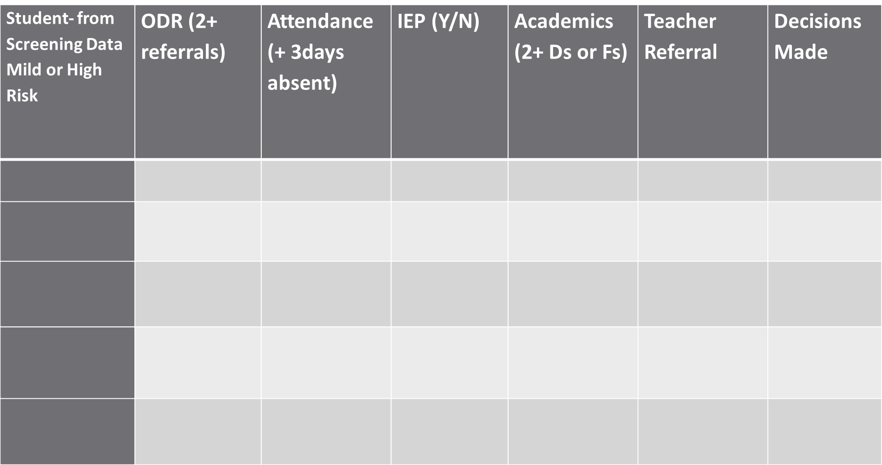
Create a template to collect all of your data sources in one place
Blank template online at: www.onewildcounselor.weebly.com
Notes:
A visual of what we are implying. Screening data will be placed on the left, other data sources will be tracked and then decisions will be made.
Lets now go into briefly about screening and why we would suggest that you use that as the gate keeper.
- TG and TD will model with think alouds.

Slide 24
Creating Effective Interventions
Step 1: Assess Current Interventions
Step 2: Using Data to Identify Student Need
Screening, ODR, Attendance, Academic, Minor Incidents
Step 3: Identify & Describe Intervention
Step 4: Create Intervention Guidelines: Determine Entry Criteria
Step 5: Identify Outcome Measures
Step 6: Identify Exit Criteria
Step 1: Construct your assessment schedule
Step 2: Identify your secondary (Tier 2) supports
Existing and new interventions
Step 3: Determine entry criteria
Nomination, academic failure, behavior and academic screening scores, attendance data etc.
Step 4: Identify outcome measures
Pre and post tests, CBM, office discipline data, GPA, state assessments, etc.
Step 5: Identify exit criteria
Reduction of discipline contacts, demonstration of grade level performance based on academic progress monitoring data, reduction of truancies and absences, etc.
Step 6: Consider additional needs

Slide 25
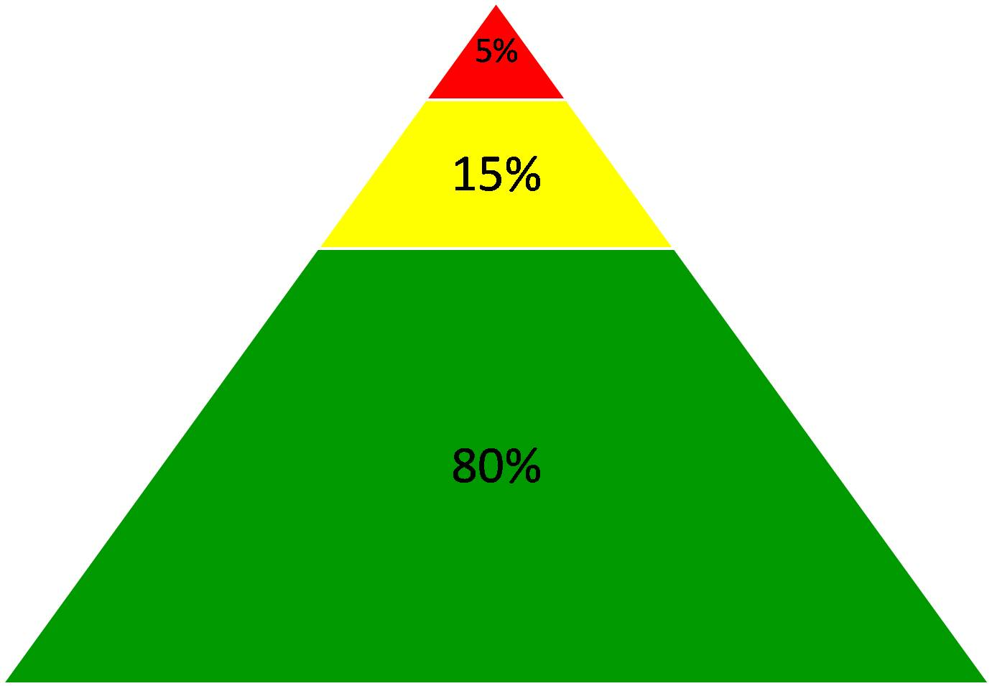
Comprehensive, Integrated, Three-tiered (CI3T) Model of Prevention
(Lane, Kalberg, & Menzies, 2009)
Goal: Reduce Harm
Specialized Individual Systems
for Students with High-Risk
≈
Tertiary Prevention (Tier 3)
Goal: Reverse Harm
Specialized Group Systems
for Students At-Risk
≈
Secondary Prevention (Tier 2)
PBIS Framework
Goal: Prevent Harm
School/Classroom-Wide Systems for All Students, Staff, & Settings
Validated Social Skills/ Character Education Curricula
≈
Primary Prevention (Tier 1)
Academic
Behavioral
Social

Slide 26
Secondary Prevention Targeted Interventions
Students who do not respond to the primary prevention
plan, 10-15% of students
Focused intervention to address academic, behavior, or social
concerns:
Acquisition (can’t do)
Fluency (trouble doing)
Performance (won’t do)
Examples of Secondary Prevention
Social Skills
Check-in/Check-Out
Mentoring
Small Groups

Slide 27
Secondary Prevention Targeted Interventions
Are at-risk for an academic and/or social-
behavioral concern
Continue to engage in frequent problem behavior despite effective school-wide, tier 1 prevention efforts
Need additional teaching, monitoring and feedback
Could benefit from extra attention or support at school before they are in crisis

Slide 28
Intervention Guidelines
Support | Description | School-wide Data: Entry Criteria | Data to Monitor Progress | Exit Criteria
The Name of the Intervention Academic, Behavioral, Or Social Skills Grade Level | A Brief description of what the intervention is, length of time, and what the outcome would be. Resources allocated to the intervention | Data sources that determine which students are best for this intervention Function Based Attention or Avoidance | Process on how data will be monitored Process on how often data will be monitored What data will be monitored | Data sources that will determine when: Adjustments need to be made Fading in order to graduate Discontinuation of interventions
Notes:
Explanation of each section- ask group / volunteers if they can articulate what this is.
This is what they will be working to create along with the plans.
Definitions of intervention guidelines – blank sheet (blue) on table
The description of this intervention is specific for the group you are teaching

Slide 29
Sample Secondary Intervention Grid
Secondary Prevention Intervention Guideline
Intervention Development
Label your intervention support & description for your Intervention Guideline
Support | Description | Schoolwide Data: Entry Criteria | Data to Monitor Progress | Exit Criteria
Behavior Contract | A written agreement between two parties used to specify the contingent relationship between the completion of a behavior and access to or delivery of a specific reward. Contract may involve administrator, teacher, parent, and student.
Stepping Stones to Literacy (Nelson, Cooper, & Gonzalez, 2004) | Supplemental reading program to address rapid automatic naming, print awareness, alphabetic phonics, phonological awareness, listening comprehension. K-3 Students Small Group (<5) or one-on-one format. Five days/week for 15-20 minutes
Notes:
*See Systematic Screenings of Behavior to Support Instruction page 54 for Stepping Stones to Literacy

Slide 30
Creating Effective Interventions
Step 1: Assess Current Interventions
Step 2: Using Data to Identify Student Need
Screening, ODR, Attendance, Academic, Minor Incidents
Step 3: Identify & Describe Intervention
Step 4: Create Intervention Guidelines: Determine Entry Criteria
Step 5: Identify Outcome Measures
Step 6: Identify Exit Criteria
Step 1: Construct your assessment schedule
Step 2: Identify your secondary (Tier 2) supports
Existing and new interventions
Step 3: Determine entry criteria
Nomination, academic failure, behavior and academic screening scores, attendance data etc.
Step 4: Identify outcome measures
Pre and post tests, CBM, office discipline data, GPA, state assessments, etc.
Step 5: Identify exit criteria
Reduction of discipline contacts, demonstration of grade level performance based on academic progress monitoring data, reduction of truancies and absences, etc.
Step 6: Consider additional needs

Slide 31
Intervention Guidelines
Support | Description | School-wide Data: Entry Criteria | Data to Monitor Progress | Exit Criteria
The Name of the Intervention Academic, Behavioral, Or Social Skills Grade Level | A Brief description of what the intervention is, length of time, and what the outcome would be. Resources allocated to the intervention | Data sources that determine which students are best for this intervention Function Based Attention or Avoidance | Process on how data will be monitored Process on how often data will be monitored What data will be monitored | Data sources that will determine when: Adjustments need to be made Fading in order to graduate Discontinuation of interventions
Notes:
Explanation of each section- ask group / volunteers if they can articulate what this is.
This is what they will be working to create along with the plans.
Definitions of intervention guidelines – blank sheet (blue) on table
The description of this intervention is specific for the group you are teaching

Slide 32
Key Features of Targeted Interventions
Increase structure and feedback
Is temporary
Provides regular & frequent opportunities for success and recognition
May include social, social emotional and/or behavior skills instruction
May require academic assistance
Transfer and Generalization Plan

Slide 33
Data Used to Identify Students in Need of Support
Universal Screeners (SRSS, AIMSweb, SSBD, BESS etc.)
Student outcome data:
Office Discipline Referrals (ODRs)
Suspensions
Attendance
Tardies
Academics
Requests for Assistance made by teachers, family members and/or students (Staff Recommendations)
Minors
In-School detentions
Interclass Time-out / “Think Time”
Notes:
3:21
At this point you are going to think about what data is relevant to your school your context.
What data is the gate keeper? Usually it is screening data
What other data will use you use to cross reference the t data sources to see if a student needs an intervention.

Slide 34
Entry Criteria: Key Features
At least 2 data sources are used to identify students for Tier 2 and Tier 3 supports at least twice a year.
A written policy exists and staff are trained.
Staff & family are notified of a decision within 10 days of making a referral.
Students begin receiving supports within 10-30 days of referral.
Notes:
3:23

Slide 35
Sample Secondary Intervention Grid
Secondary Intervention Guidelines
Support | Description | Schoolwide Data: Entry Criteria | Data to Monitor Progress | Exit Criteria
Social & Academic Social Skill Instructional Groups | -Focuses on improving students’ social skills. -Two/three days a week -Sessions conducted by counselor and or teacher during Student Success (Advisory) or AE Examples: -Problem-solving: To learn replacement behaviors for fighting, arguing, etc. -Pro-social Skills: To learn replacement behaviors for avoidance, withdrawal, etc. -Academic Behaviors: To learn replacement behaviors for getting out of seat, calling out during instruction, poor studying habits, etc. -Internalizing Behavior: | To be considered data must meet two out of the following areas: -Academic & behavior concerns which look like: Screening score in moderate-risk range on the SRSS, Three or more ODRs in a trimester Two or more out of school suspensions Failing 2 or more core academic classes 3 or more unexcused absences AND -Function of student behavior related to peer-related problems | -Reduction in ODRs -Daily social skills checklists (Cool Card) -Direct observation(teachers) -Grades -Attendance -Behavior surveys Data Example: After 4-6 weeks of the social skills instructional group, 7 of the 8 students have earned 80% or more of their Cool Card points and there has been a 50% reduction in total ODRs for the 8 students. | -Student scores in the low-risk status during the next screening -No ODRs related to peer problems during the reporting cycle -Students are able to exhibit generalized skill in specific setting
New Comer’s Club | -Structured program that provides new students opportunities to learn school-wide expectations, develop friendships by participating peer mentorship and to access positive reinforcement. | Any student who is new or reintroduced to the building. Students who have two or more school changes in a given year Student Peers will be selected based on teacher recommendations Ambassadors should have passing grades in all academic areas with a C or higher. | Pre and post social validity surveys will be analyzed for staff, students and families. | Students know and practice the school-wide expectations, and Report that they have developed friendships As evident within the post social validity survey.
Targeted Intervention Manual in Resources
Notes:
3:25
Criteria for access to Tier 2 interventions is clearly established
All staff trained on how to make a referral, and how to implement the intervention
Data are used continuously to monitor progress and to determine when a student will exit the intervention or when supports will be intensified.
System for communicating with participating student, staff and families is developed.

Slide 36
Intervention Development: Entry Criteria
What criteria or possible data sources will you use to determine which students need a Tier 2/3 targeted intervention?
Add Entry Criteria information to your Intervention Guideline
Notes:
3:27

Slide 37
Creating Effective Interventions
Step 1: Assess Current Interventions
Step 2: Using Data to Identify Student Need
Screening, ODR, Attendance, Academic, Minor Incidents
Step 3: Identify & Describe Intervention
Step 4: Create Intervention Guidelines: Determine Entry Criteria
Step 5: Identify Outcome Measures
Step 6: Identify Exit Criteria
Step 1: Construct your assessment schedule
Step 2: Identify your secondary (Tier 2) supports
Existing and new interventions
Step 3: Determine entry criteria
Nomination, academic failure, behavior and academic screening scores, attendance data etc.
Step 4: Identify outcome measures
Pre and post tests, CBM, office discipline data, GPA, state assessments, etc.
Step 5: Identify exit criteria
Reduction of discipline contacts, demonstration of grade level performance based on academic progress monitoring data, reduction of truancies and absences, etc.
Step 6: Consider additional needs
Notes:
3:29

Slide 38
Intervention Guidelines
Support | Description | School-wide Data: Entry Criteria | Data to Monitor Progress | Exit Criteria
The Name of the Intervention Academic, Behavioral, Or Social Skills Grade Level | A Brief description of what the intervention is, length of time, and what the outcome would be. Resources allocated to the intervention | Data sources that determine which students are best for this intervention Function Based Attention or Avoidance | Process on how data will be monitored Process on how often data will be monitored What data will be monitored Social Validity Treatment Integrity | Data sources that will determine when: Adjustments need to be made Fading in order to graduate Discontinuation of interventions
Notes:
How will data be gathered by the designated teacher for this intervention?
How will it be reported?
How will it be communicated to all stakeholders?
When will it be reviewed?
How will treatment and social validity data be collected?

Slide 39
Intervention Development: Data to Progress Monitor
Collect and analyze universal data monthly
Collect and analyze secondary intervention data bi-weekly
Collect and analyze individual intervention data weekly
Notes:
3:30

Slide 40
SOCIAL VALIDITY (Perception)
Social validity refers to the social significance of the intervention goals, the social acceptability of the intervention procedures, and the social importance of effects of the intervention (Kazdin, 1977)
Is the intervention practical?
Is the intervention feasible?
Is the intervention cost-effective?
Does the intervention target socially important goals?
Does the intervention result in socially important outcomes?
Notes:
3:32
Taken from the BAT rubric
Function of behavior, strengthening the problem solving process

Slide 41
SOCIAL VALIDITY
When?
Before implementation
Who?
Multiple perspectives
During implementation
After implementation
Teachers
Administrators
Paraprofessionals
Students
Parents
Staff
Notes:
3:33

Slide 42
Pre-Post Mentoring SOCIAL VALIDITY
Statement | Strongly Disagree | Somewhat Disagree | Somewhat Agree | Strongly Agree
1. Teachers help me. | 1 | 2 | 3 | 4
2. I like to come to school. | 1 | 2 | 3 | 4
3. I have friends at school. | 1 | 2 | 3 | 4
4. I believe doing well in school is important. | 1 | 2 | 3 | 4
Notes:
3:33

Slide 43
TREATMENT INTEGRITY
Treatment integrity is a measure of the accuracy with which the plan is implemented as intended
Source: Lane, K. L., Kalberg, J. R., & Menzies, H. M. (2009). Developing schoolwide programs to prevent and manage problem behaviors: A step-by-step approach. New York: Guilford Press.
Notes:
3:34
New intervention assesses weekly
New implementer assesses weekly, self-assess daily
25% ratio to compare to an outside observer
If less than 70% of students are responding positively to any of the interventions, the Tier 2/3 Systems team should review the treatment integrity of the intervention and make adjustments as needed

Slide 44
TREATMENT INTEGRITY
Assess intervention within two weeks of implementing
If less than 70% of students are responding positively to any of the interventions, best practice is to review the treatment integrity of the intervention and make adjustments as needed
Source: Lane, K. L., Kalberg, J. R., & Menzies, H. M. (2009). Developing schoolwide programs to prevent and manage problem behaviors: A step-by-step approach. New York: Guilford Press.
Notes:
3:35
New intervention assesses weekly
New implementer assesses weekly, self-assess daily
25% ratio to compare to an outside observer
If less than 70% of students are responding positively to any of the interventions, the Tier 2/3 Systems team should review the treatment integrity of the intervention and make adjustments as needed

Slide 45
CICO Treatment Integrity Checklist
COMPONENT | Absent | 25% of time | 50% of the time | 75% of the time | 100% of the time
I greet the students before class in a positive, friendly manner.
I provide the students specific positive and/or corrective feedback throughout the period.
I provide the students with a score on goals along with feedback at the end of the day/period.
I provide pre-corrects to the students.
I remind the student to check-in.
I remind the student to check-out.
I check to make sure the DPR is in the student’s backpack or with them.
Notes:
Create your own treatment integrity tool, will have reading and supply examples
Right now – think about what has been done at Tier 1 or anything else going on in school (academic interventions, scope and sequence, other work -), how is it monitored that it is happening as intended? and make connections to Tier 2/3
Connections to academics and treatment integrity

Slide 46
Sample Secondary Intervention Grid
Secondary Intervention Grid
Support | Description | Schoolwide Data: Entry Criteria | Data to Monitor Progress | Exit Criteria
Behavior Contract | A written agreement between two parties used to specify the contingent relationship between the completion of a behavior and access to or delivery of a specific reward. Contract may involve administrator, teacher, parent, and student. | Behavior: SRSS - mod to high risk Academic: 2 or more missing assignments within a grading period 2-5 ODR re: disruptive attention-seeking behavior | Work completion, or other behavior addressed in contract collected weely Treatment Integrity Social Validity
Stepping Stones to Literacy (Nelson, Cooper, & Gonzalez, 2004) | Supplemental reading program to address rapid automatic naming, print awareness, alphabetic phonics, phonological awareness, listening comprehension. K-3 Students Small Group (<5) or one-on-one format. Five days/week for 15-20 minutes | Academic: K-3 Students AIMSweb reading—deficient or emerging in Fall and Winter And Behavior: SSBD exceeded normative criteria for internalizing or externalizing dimension | Weekly reading probes—AIMSweb Treatment Integrity Social Validity
What could Social Validity & Treatment Integrity look like for your intervention?
Add this information to your Assessment Schedule
Notes:
3:36
Add specifics to what data you would monitor. For behavior plans or contracts – we may want to look at ODR data, behavioral data, work completion. Schedule times to meet and review the plan. Utilize treatment integrity data for fidelity of implementation.

Slide 47
Creating a Tier 2 System to Respond
Step 1: Construct an Assessment Schedule
Step 2: Using Data to Identify Student Need
Screening, ODR, Attendance, Academic, Minor Incidents
Step 3: Identify your Secondary (Tier 2) Supports
Step 4: Create Intervention Guidelines: Determine Entry Criteria
Step 5: Identify Outcome Measures
Step 6: Identify Exit Criteria
Step 1: Construct your assessment schedule
Step 2: Identify your secondary (Tier 2) supports
Existing and new interventions
Step 3: Determine entry criteria
Nomination, academic failure, behavior and academic screening scores, attendance data etc.
Step 4: Identify outcome measures
Pre and post tests, CBM, office discipline data, GPA, state assessments, etc.
Step 5: Identify exit criteria
Reduction of discipline contacts, demonstration of grade level performance based on academic progress monitoring data, reduction of truancies and absences, etc.
Step 6: Consider additional needs

Slide 48
Intervention Guidelines
Support | Description | School-wide Data: Entry Criteria | Data to Monitor Progress | Exit Criteria
The Name of the Intervention Academic, Behavioral, Or Social Skills Grade Level | A Brief description of what the intervention is, length of time, and what the outcome would be. Resources allocated to the intervention | Data sources that determine which students are best for this intervention Function Based Attention or Avoidance | Process on how data will be monitored Process on how often data will be monitored What data will be monitored Treatment Integrity Social Validity | Data sources that will determine when: Adjustments need to be made Fading in order to graduate Discontinuation of interventions
Notes:
3:39
Explanation of each section- ask group / volunteers if they can articulate what this is.
This is what they will be working to create along with the plans.
Definitions of intervention guidelines – blank sheet (blue) on table
The description of this intervention is specific for the group you are teaching

Slide 49
Intervention Development: EXIT Criteria
What student outcome do you intend to impact?
Related back to your Decision Rules of “Student Response to Interventions”
How much of the progress monitoring is a part of this criteria?
Time bound - (ex: 4 weeks of meeting criteria)
Transition Plan- How will we graduate, fade out or transition students to additional intervention.
Notes:
3:39
Function of behavior, strengthening the problem solving process

Slide 50
Intervention Development: EXIT Criteria
Screening scores with marked improvement
ODR Office Discipline Referrals
Suspensions
Attendance
Tardies
Academics
Follow-up questionnaire for teachers, family member, or student who made referral
Notes:
3:40

Slide 51
Sample Secondary Intervention Grid
Secondary Intervention Guideline
Support | Description | School wide Data: Entry Criteria | Data to Monitor Progress | Exit Criteria
Behavior Contract | A written agreement between two parties used to specify the contingent relationship between the completion of a behavior and access to or delivery of a specific reward. Contract may involve administrator, teacher, parent, and student. | Behavior: SRSS - mod to high risk Academic: 2 or more missing assignments within a grading period 2-5 ODR re: disruptive attention-seeking behavior | Work completion, or other behavior addressed in contract Treatment Integrity Social Validity | Behavior: SRSS: - low to mod risk Academic: reduced rate of missing assignments over designated time frame Reduced ODR’s
Stepping Stones to Literacy (Nelson, Cooper, & Gonzalez, 2004) | Supplemental reading program to address rapid automatic naming, print awareness, alphabetic phonics, phonological awareness, listening comprehension. K-3 Students Small Group (<5) or one-on-one format. Five days/week for 15-20 minutes | Academic: K-3 Students AIMSweb reading—deficient or emerging in Fall and Winter And Behavior: SSBD exceeded normative criteria for internalizing or externalizing dimension | Weekly reading probes—AIMSweb Treatment Integrity Social Validity | Academic: AIMSweb –meet reading bench mark at Spring time point
Intervention Development
Complete what exit criteria data you may utilize for your intervention
Notes:
3:42

Slide 52
Tiered Intervention Tracking Tool
Tier 2 Interventions | CICO |  | Social Skills |  | Mentoring
 | # Students Participating | # Students Responding | # Students Participating | # Students Responding | # Students Participating | # Students Responding
August
September
October
November
December
January
February
March
April
May

Slide 53
Questions? Considerations?
What opportunities might creating intervention guidelines surface for your school?
Notes:
3:43
53

Slide 54
Matthew Berry
PBIS Facilitator
314-989-7873
mbberry@ssdmo.org
onewildcounselor@gmail.com
www.onewildcounselor.weebly.com
@1wildcounselor
Connect with Me!

